Slide 1
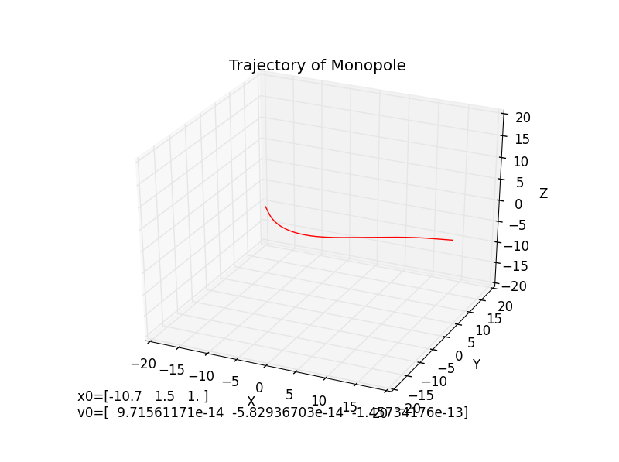
Magnetic Monopoles in the Milky Way Galaxy
Notes:
Image src: my own simulations

Slide 2
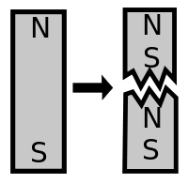

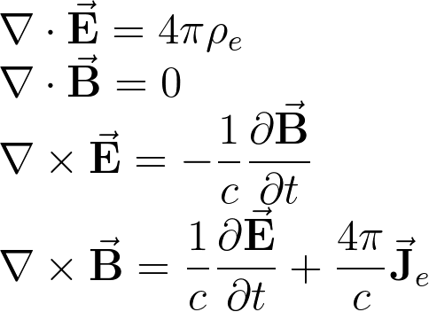
What are magnetic monopoles?
A particle whose magnetic field is like the field of a single-pole magnet.
This would produce a Coulomb law for magnetism.
Why do we believe in them?
Dirac quantization condition:
Symmetry of Maxwell’s Equations
GUTs predict them
Notes:
Image src: wikipedia

Slide 3
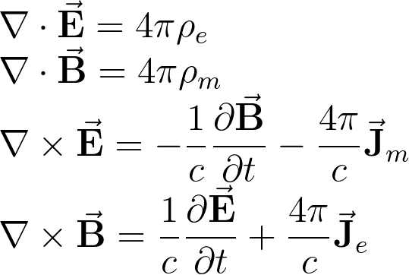
What are magnetic monopoles?
A particle whose magnetic field is like the field of a single-pole magnet.
This would produce a Coulomb law for magnetism.
Why do we believe in them?
Dirac quantization condition:
Symmetry of Maxwell’s Equations
GUTs predict them

Slide 4
Searches for the elusive monopole…
Many ideas have been proposed. Physicists have searched for monopoles in cosmic rays, embedded in the Earth’s crust, drifting through the atmosphere, produced in high-energy collisions, and more.
No statistically significant success.
There is hope: The mass is not known, but GUTs predict ~10¹⁵GeV/c². This single particle is 20x heavier than a human blood cell and 10¹⁵ times m_{proton}.
Notes:
Src for this info: Sloan Non-collider searches for stable massive particles arXiv:1410.1374v1 [hep-ph] 6 Oct 2014 Src for 20x blood cell: wolfram alpha search “1e15GeV/c^2”

Slide 5

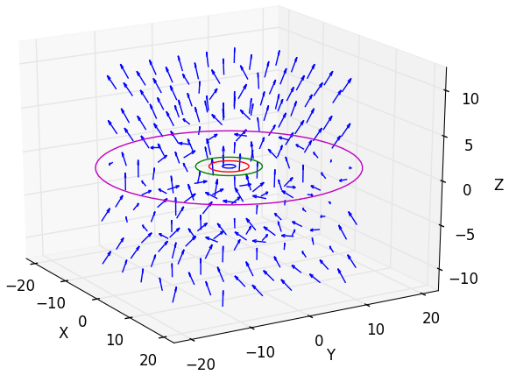

The Galactic Magnetic Field
In 2012, Professor Glennys Farrar came up with an improved model of the Milky Way magnetic field.
The motion of monopoles can now be studied more precisely.
Does the magnetic field shield us from monopoles? Simulations can provide an answer.
Fun fact: it is piecewise in ~30 pieces
Notes:
Src for this info: Sloan Non-collider searches for stable massive particles arXiv:1410.1374v1 [hep-ph] 6 Oct 2014 Src for 20x blood cell: wolfram alpha search “1e15GeV/c^2”

Slide 6
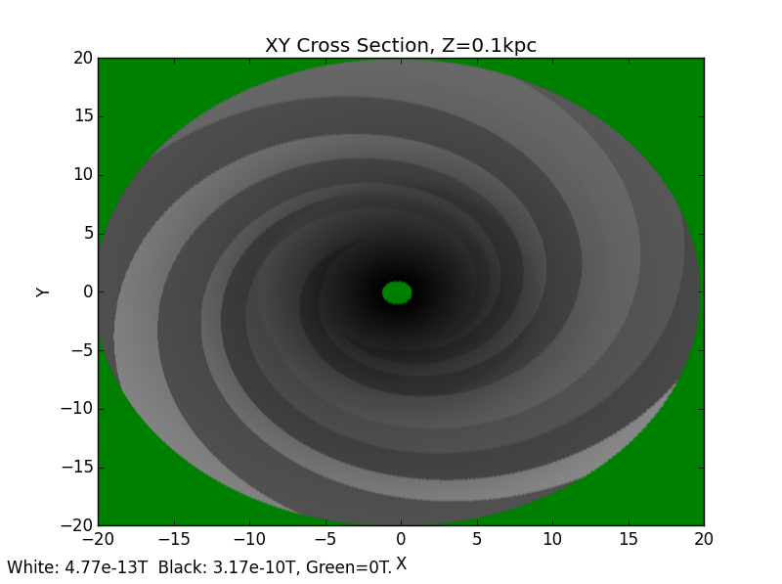
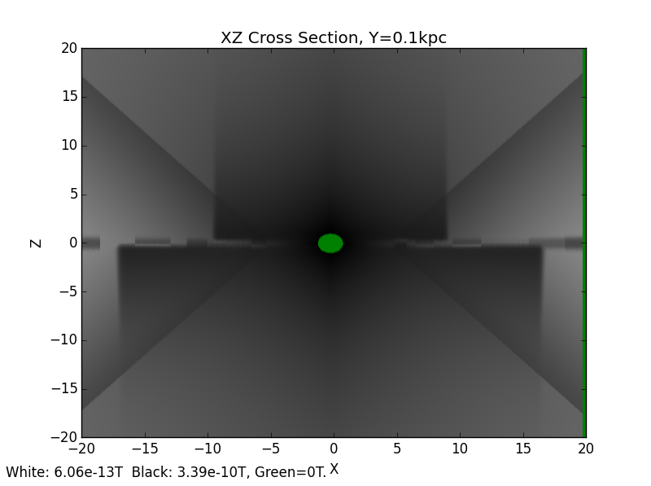
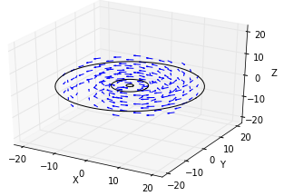
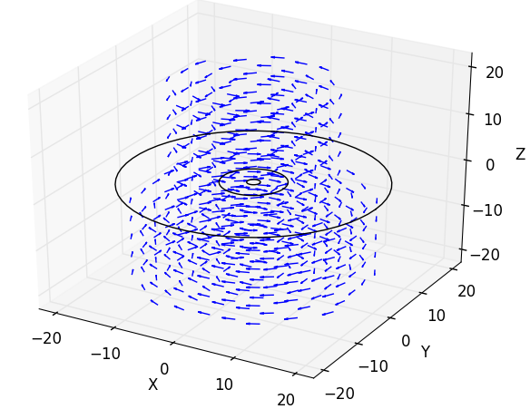
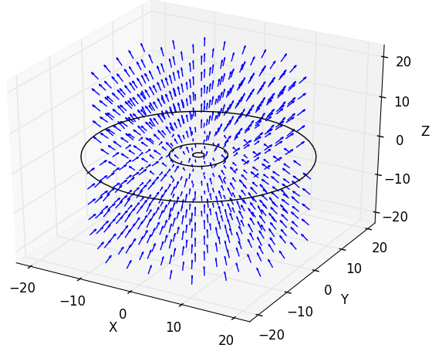
+
+
Disk Field
Halo Field
X-Field
Notes:
All diagrams in this slide are self-made.

Slide 7
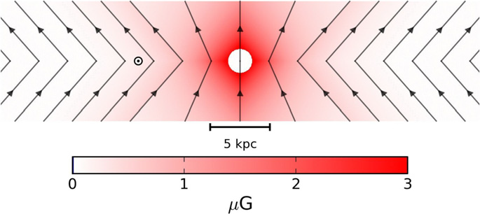
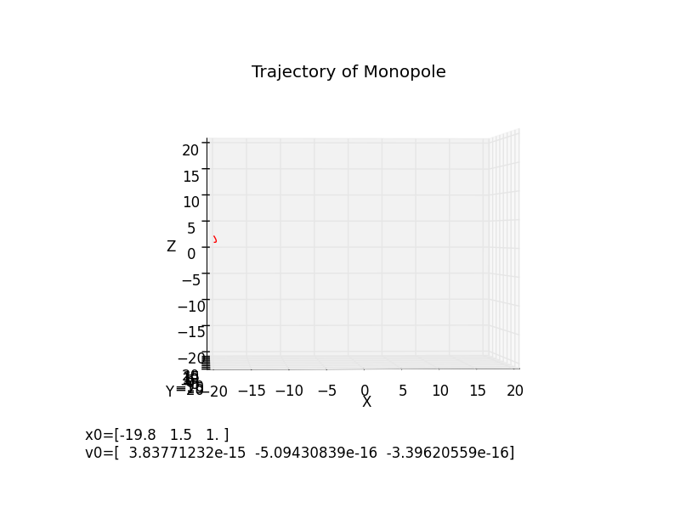
The field repels positive monopoles from the upper hemisphere & pulls them in from the lower hemisphere
Opposite for negative monopoles
This can reduce an isotropic flux by at most 50%
Wrote 4th order Runge-Kutta solver in Python to find out the energy at which monopoles can tunnel through to the earth
Dynamics had to be relativistic
Simple method: increase starting velocity until the monopole reaches a radius of 8.5kpc
Gravitational field is negligible for monopoles with m << 1e17GeV/c²
Above: X-field Component
Notes:
X-field diagram taken from Jansson, Farrar (2012): A New Model of the Galactic Magnetic Field. The rest are a result of plotting my simulations.

Slide 8
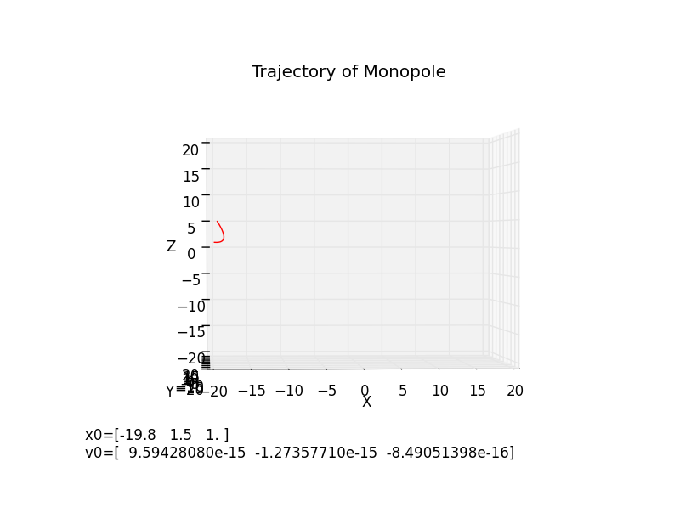
The field repels positive monopoles from the upper hemisphere & pulls them in from the lower hemisphere
Opposite for negative monopoles
This can reduce an isotropic flux by at most 50%
Wrote 4th order Runge-Kutta solver in Python to find out the energy at which monopoles can tunnel through to the earth
Dynamics had to be relativistic
Simple method: increase starting velocity until the monopole reaches a radius of 8.5kpc
Above: X-field Component

Slide 9

The field repels positive monopoles from the upper hemisphere & pulls them in from the lower hemisphere
Opposite for negative monopoles
This can reduce an isotropic flux by at most 50%
Wrote 4th order Runge-Kutta solver in Python to find out the energy at which monopoles can tunnel through to the earth
Dynamics had to be relativistic
Simple method: increase starting velocity until the monopole reaches a radius of 8.5kpc
Above: X-field Component

Slide 10
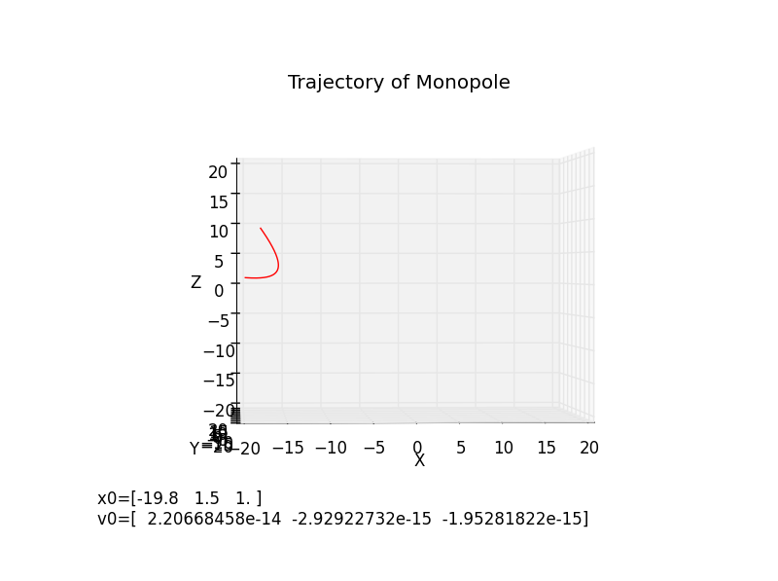
The field repels positive monopoles from the upper hemisphere & pulls them in from the lower hemisphere
Opposite for negative monopoles
This can reduce an isotropic flux by at most 50%
Wrote 4th order Runge-Kutta solver in Python to find out the energy at which monopoles can tunnel through to the earth
Dynamics had to be relativistic
Simple method: increase starting velocity until the monopole reaches a radius of 8.5kpc
Above: X-field Component

Slide 11

The field repels positive monopoles from the upper hemisphere & pulls them in from the lower hemisphere
Opposite for negative monopoles
This can reduce an isotropic flux by at most 50%
Wrote 4th order Runge-Kutta solver in Python to find out the energy at which monopoles can tunnel through to the earth
Dynamics had to be relativistic
Simple method: increase starting velocity until the monopole reaches r_{earth}= 8.5kpc
Above: X-field Component

Slide 12
Results:
Monopoles can first tunnel through to the earth at kinetic energies of 5e10 GeV, but only from ideal angles of entry.
Starting at kinetic energies of 1.3e12 GeV, monopoles can reliably enter at any angle.
Consistent with order-of-magnitude calculations
Independent of monopole mass!
=> Flux is halved for monopoles with kinetic energy less than 5e10GeV. It then increases with monopole energy until 1.3e12GeV, at which point it is unaffected by the magnetic field.

